Slide 1
Welcome to the
RMMBA Camp!
Rocky Mountain Missionary Baptist Association (RMMBA)
Camp Orientation

Slide 2
Song
Sam Powell
  Bradley Road Missionary Baptist Church
Jennifer Barron, piano
  Landmark Missionary Baptist Church

Slide 3
Opening Prayer & Devotional
Jeff Barron
  Landmark Missionary Baptist Church

Slide 4
Orientation Agenda
Song
Opening Prayer & Devotional
Camp Officers
Camp Facilities and Boundaries
Summary of the Camp Rules
Schedule of Activities
Meals & Snacks
Cabin Clean Up and Inspections
Devotionals and Evening Messages
Dismissal Prayer

Slide 5
Camp Officers
Directors
Secretary-Treasurer
Education
Music
Sports & Recreation
Arts & Crafts
Jeff Barron
Eddie Vigil, Assistant
Trish Elizalde
Eddie Vigil
Sam Powell
Kathy Rademacher
Judy Powell
Jennifer Barron, piano

Slide 6
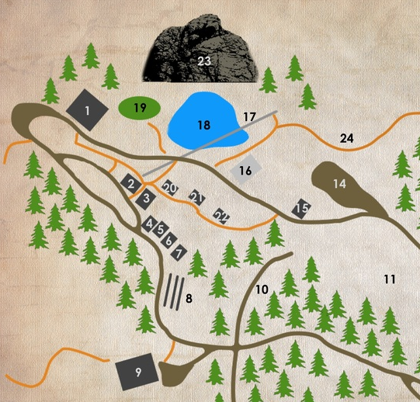
Camp Facilities Map
1. Lodge and Med Cabin
2. Bathhouse
3. Willow (Lake, Up)
3. Lodgepole (Road, Up)
3. Ponderosa (Lake, Down)
3. Aspen (Road, Down)
4. Summit View
5. Timber Ridge
6. Glacier Point
7. Boulder Gap
8. Aspen Chapel
9. Willis Activity Center (WAC)
21. Human Foosball

Slide 7
Summary of Camp Rules
(1 of 2)
Everyone must conduct themselves as becoming to the cause of Christ (proper language and respect for personal or camp property).
Proper clothing must be worn at all times.
No camper should remain in cabins during camp activities. Cabins are assigned by gender (boys and girls), and campers are only permitted to enter cabins where their gender is assigned.
Anyone sick or injured should report to a counselor of camp nurse. All medications should be dispensed by the camp nurse if available.
Each church counselor/pastor is responsible for their campers.

Slide 8
Summary of Camp Rules
(2 of 2)
Alcohol, marijuana products, legal drugs intended for recreational use, firearms, gambling devices, tobacco and nicotine products, and illegal drugs are prohibited. Fireworks, animals, hunting knives, paint-ball or pellet guns are prohibited.
Personal electronic devices are not allowed.
Everyone must attend class and worship services.
All campers must stay in the immediate camping area unless with an adult counselor on an organized hike.
Holding hands or lip contact with anyone you aren’t married to are neither necessary nor permissible.
No one is to leave the campgrounds without first notifying the Camp Director.

Slide 9
Camp Schedule
If you're early, you're on time.
If you're on time, you're late.
If you're late, you're left.
Campers (youth and adults) are required to participate in all activities
Schedule of Activities
  Classes
  Recreation
  Crafts

Slide 10
Meals & Snacks
Preparing for Meals
Come into the Lodge quietly and sit at the tables
Pray for God's blessing on the meal
Wait for your table to be dismissed (one table at a time)
When everyone has been served, the Camp Eden staff will let us know if we can get more food.
Clean up
Take your plate, cup, utensils, and trash to cart
Put food scraps and trash in trash can
Snacks
Snacks will be provided in the afternoon
Poor liquid in bucket on cart
Get a rag and wipe down your table
We will meet in the Lodge or other designated location

Slide 11
Cabin Clean Up and Inspections
Cabin Clean Up
Make beds
Put personal belongings in suitcases or closets
Sweep cabin and porches
Empty trash and take trash bags to bathhouse
Replace trash bags
Cabin Inspectors
Girls
Adults in Cabins
Boys
Adults in Cabins

Slide 12
Teachers for Classes
Adults
Eddie Vigil or Sam Powell or Ike Thompson
High School
(grades 9-12)
Jeff Barron
Primary
(grades 1-3)
Sue McGowan
Lodge Front Porch
Lodge
WAC, upstairs
WAC, upstairs
Sue McGowan
Tiny Tots
(Grades <=K)
Lodge
Jeff Barron
Junior
(grades 4-5)
Lodge
Jeff Barron
Junior High
(grades 6-8)

Slide 13
Recreation, Crafts, & Music
Recreation
Recreation activities will be announced at the afternoon assembly every day
Crafts
Arts and Crafts will be set up in the WAC
Music
If you have special music you want to share, please see Sam Powell

Slide 14
Devotionals and Messages
Wednesday
Tuesday
Jeff Barron
Message
Devotional
Message
Thursday
Devotional
Message
Friday
Devotional
Devotional
Jeff Barron
Jeff Barron
Jeff Barron
Anthony Ferguson
Ike Thompson
Eddie Vigil

Slide 15
Have a Great
Week of Camp!
Rocky Mountain Missionary Baptist Association (RMMBA)
Camp Orientation

